Slide 1
C++
Md. Abdur Rahman
Senior Computer Scientist
Centre for Advanced in Research in Sciences (CARS)
University of Dhaka

Slide 2
Control Statement
A program usually follow liner sequence to execute.
Statement One
Statement Two
… …
Statement N
Linear programs like these are very limited in the problems they can solve.

Slide 3
Control Statement
if-else
Switch
For Loop
While Loop
Do-While Loop
Break Statement
Continue Statement
Goto Statement
Comments

Slide 4
if statements
if statement
if-else statement
nested if statement
if-else-if ladder

Slide 5
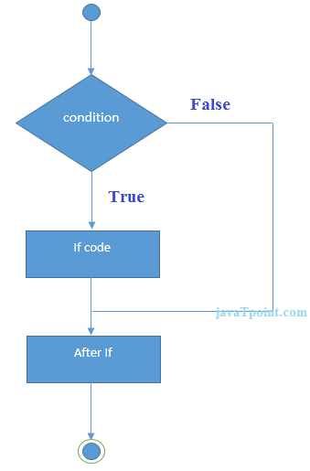
C++ IF Statement
if statement tests the condition. It is executed if condition is true.
if(condition){
//code to be executed
}
#include <iostream>
using namespace std;
int main () {
int num = 10;
if (num % 2 == 0)
{
cout<<"It is even number";
}
return 0;
}

Slide 6
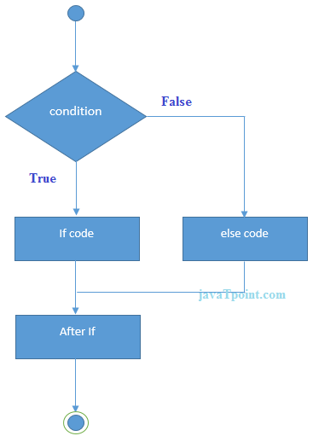
IF-else Statement
if(condition){
//code if condition is true
}else{
//code if condition is false
}

Slide 7
IF-else Statement
#include <iostream>
using namespace std;
int main () {
int num = 11;
if (num % 2 == 0)
{
cout<<"It is even number";
}
else
{
cout<<"It is odd number";
}
return 0;
}

Slide 8
If-else Example: with input from user
#include <iostream>
using namespace std;
int main () {
int num;
cout<<"Enter a Number: ";
cin>>num;
if (num % 2 == 0)
{
cout<<"It is even number"<<endl;
}
else
{
cout<<"It is odd number"<<endl;
}
return 0;
}

Slide 9
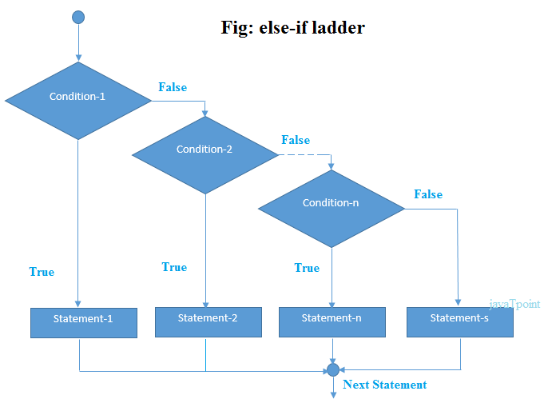
IF-else-if ladder Statement

Slide 10
IF-else-if ladder Statement
if(condition1){
//code to be executed if condition1 is true
}else if(condition2){
//code to be executed if condition2 is true
}
else if(condition3){
//code to be executed if condition3 is true
}
...
else{
//code to be executed if all the conditions are false
}

Slide 11
If else-if Example
#include <iostream>
using namespace std;
int main () {
int num;
cout<<"Enter a number to check grade:";
cin>>num;
if (num <0 || num >100)
{ cout<<"wrong number"; }
else if(num >= 0 && num < 50)
{
cout<<"Fail";
}
else if (num >= 50 && num < 60)
{
cout<<"D Grade";
}
else if (num >= 60 && num < 70)
{
cout<<"C Grade";
}
else if (num >= 70 && num < 80)
{
cout<<"B Grade";
}
else if (num >= 80 && num < 90)
{
cout<<"A Grade";
}
else if (num >= 90 && num <= 100)
{
cout<<"A+ Grade";
}
}

Slide 12
C++ switch
The C++ switch statement executes one statement from multiple conditions. It is like if-else-if ladder statement in C++
switch(expression){
case value1:
//code to be executed;
break;
case value2:
//code to be executed;
break;
......
default:
//code to be executed if all cases are not matched;
break;
}

Slide 13
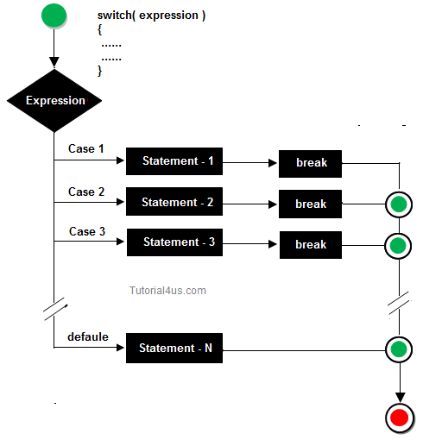
C++ switch

Slide 14
C++ Switch Example
#include <iostream>
using namespace std;
int main ()
{
int num;
cout<<"Enter a number to check grade:";
cin>>num;
switch (num)
{
case 10: cout<<"It is 10"; break;
case 20: cout<<"It is 20"; break;
case 30: cout<<"It is 30"; break;
default: cout<<"Not 10, 20 or 30"; break;
}
}

Slide 15
For Loop
The C++ for loop is used to iterate a part of the program several times.
If the number of iteration is fixed, it is recommended to use for loop than while or do-while loops.
#include <iostream>
using namespace std;
int main()
{
for(int i=1;i<=10;i++){
cout<<i <<"\n";
}
}

Slide 16
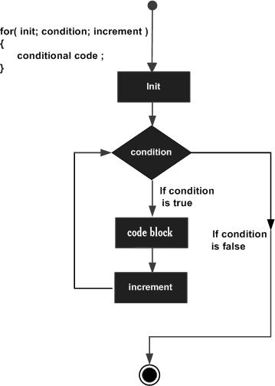
For Loop

Slide 17
Nested For Loop
we can use for loop inside another for loop, it is known as nested for loop
The inner loop is executed fully when outer loop is executed one time
So if outer loop and inner loop are executed 4 times, inner loop will be executed 4 times for each outer loop i.e. total 16 times.

Slide 18
Nested For Loop
#include <iostream>
using namespace std;
int main ()
{
for(int i=1;i<=3;i++){
for(int j=1;j<=3;j++){
cout<<i<<" "<<j<<"\n";
}
}
}

Slide 19
Infinite For Loop
If we use double semicolon in for loop, it will be executed infinite times.
#include <iostream>
using namespace std;
int main ()
{
for (; ;)
{
cout<<"Infinitive For Loop";
}
}

Slide 20
While loop
while loop is used to iterate a part of the program several times
If the number of iteration is not fixed, it is recommended to use while loop than for loop.
while(condition){
//code to be executed
}

Slide 21
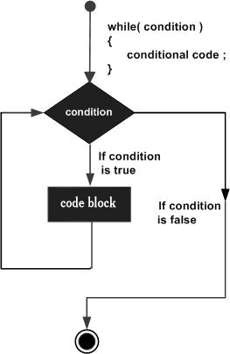
While loop
#include <iostream>
using namespace std;
int main()
{
int i=1;
while(i<=10)
{
cout<<i <<"\n";
i++;
}
}

Slide 22
Nested While Loop Example
#include <iostream>
using namespace std;
int main ()
{
int i=1;
while(i<=3)
{
int j = 1;
while (j <= 3)
{
cout<<i<<" "<<j<<"\n";
j++;
}
i++;
}
}

Slide 23
Infinitive While Loop Example:
We can also create infinite while loop by passing true as the test condition.
#include <iostream>
using namespace std;
int main ()
{
while(true)
{
cout<<"Infinitive While Loop";
}
}

Slide 24
Do-While Loop
do-while loop is used to iterate a part of the program several times.
If the number of iteration is not fixed and you must have to execute the loop at least once, it is recommended to use do-while loop.
do{
//code to be executed
}while(condition);

Slide 25
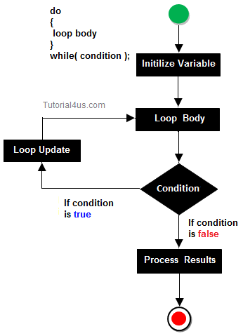
Do-While Loop

Slide 26
Do-While Loop
#include <iostream>
using namespace std;
int main()
{
int i = 1;
do{
cout<<i<<"\n";
i++;
} while (i <= 10) ;
}

Slide 27
Nested do-while Loop
The nested do-while loop is executed fully for each outer do-while loop.
include <iostream>
using namespace std;
int main()
{
int i = 1;
do{
int j = 1;
do{
cout<<i<<"\n";
j++;
} while (j <= 3) ;
i++;
} while (i <= 3) ;
}

Slide 28
Infinitive do-while Loop
if you pass true in the do-while loop, it will be infinitive do-while loop.
do{
//code to be executed
}while(true);
#include <iostream>
using namespace std;
int main()
{
do{
cout<<"Infinitive do-while Loop";
} while(true);
}

Slide 29
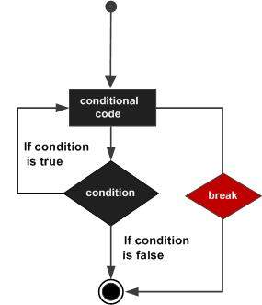
Break Statement
The C++ break is used to break loop or switch statement.
It breaks the current flow of the program at the given condition.
In case of inner loop, it breaks only inner loop.
jump-statement;
break;

Slide 30
Break Statement Example
#include <iostream>
using namespace std;
int main()
{
for (int i = 1; i <= 10; i++)
{
if (i == 5)
{
break;
}
cout<<i<<"\n";
}
}

Slide 31
Break Statement with Inner Loop
The C++ break statement breaks inner loop only if you use break statement inside the inner loop.
#include <iostream>
using namespace std;
int main()
{
for(int i=1;i<=3;i++)
{
for(int j=1;j<=3;j++)
{
if(i==2&&j==2)
{
break;
}
cout<<i<<" "<<j<<"\n";
}
}
}

Slide 32
Continue Statement
continue statement is used to continue loop
It continues the current flow of the program and skips the remaining code at specified condition
In case of inner loop, it continues only inner loop

Slide 33
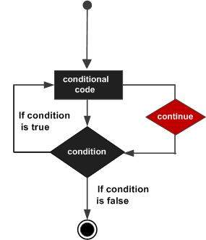
Continue Statement
jump-statement;
continue;
#include <iostream>
using namespace std;
int main()
{
for(int i=1;i<=10;i++)
{
if(i==5)
{
continue;
}
cout<<i<<"\n";
}
}

Slide 34
Continue Statement with Inner Loop
#include <iostream>
using namespace std;
int main()
{
for(int i=1;i<=3;i++)
{
for(int j=1;j<=3;j++)
{
if(i==2&&j==2)
{
continue;
}
cout<<i<<" "<<j<<"\n";
}
}
}

Slide 35
Goto Statement
The C++ goto statement is also known as jump statement.
It is used to transfer control to the other part of the program.
It unconditionally jumps to the specified label.
It can be used to transfer control from deeply nested loop or switch case label.

Slide 36
Goto Statement Example
#include <iostream>
using namespace std;
int main()
{
ineligible:
cout<<"You are not eligible to vote!\n";
cout<<"Enter your age:\n";
int age;
cin>>age;
if (age < 18)
{
goto ineligible;
}
else
{
cout<<"You are eligible to vote!";
}
}

